Slide 1
Wireless Power Transfer using Magnetic Metamaterials
Elena Chong Loo
ECE597: Electromagnetic Metamaterial
Final project
May 27, 2015
Notes:
This project is based on [1]. Many of the parameters were modified for fabrication.
[1] Q. Wu et al. “Wireless power transfer based on magnetic metamaterials consisting of assembled ultra-subwavelength meta-atoms.”, EPL, 2015.

Slide 2
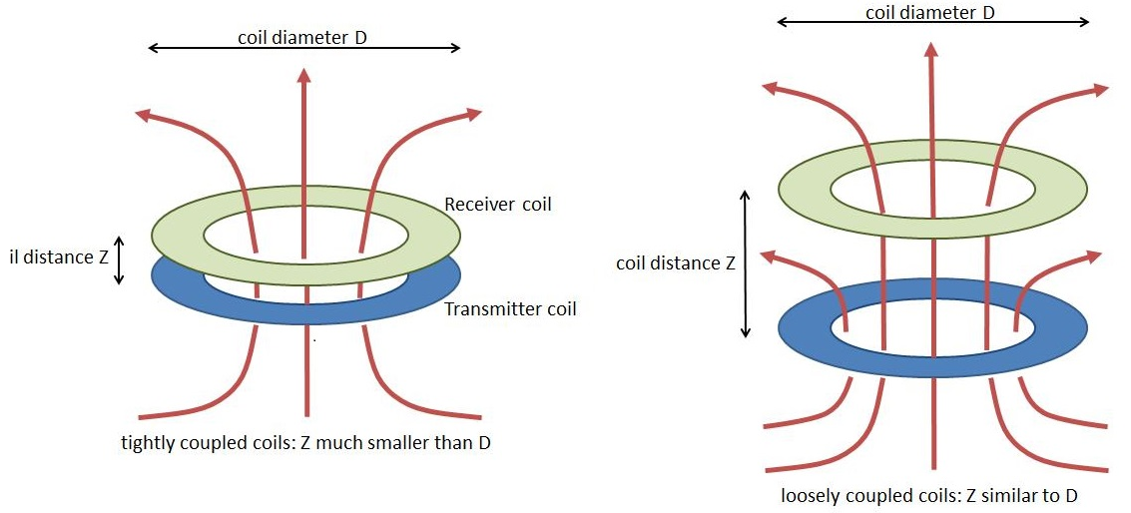
Wireless Power Transfer (WPT) Technology
Notes:
There are two kind of WPT the radiative and the non-radiative. The radiative one uses high power radiative energy transfer which can damage the surrounding. In this case, we are using a non-radiative power transfer which relies on the near-field coupling between two inductive coils. The drive coil or the transmitter coil creates the magnetic field and the receiver coil, which is a small distance away and is physically detached from the transmitter coil, gets an induced magnetic field as a product of the flux from the magnetic field created by the transmitter coil. This is using the principle of a transformer. They are magnetically coupled.

Slide 3
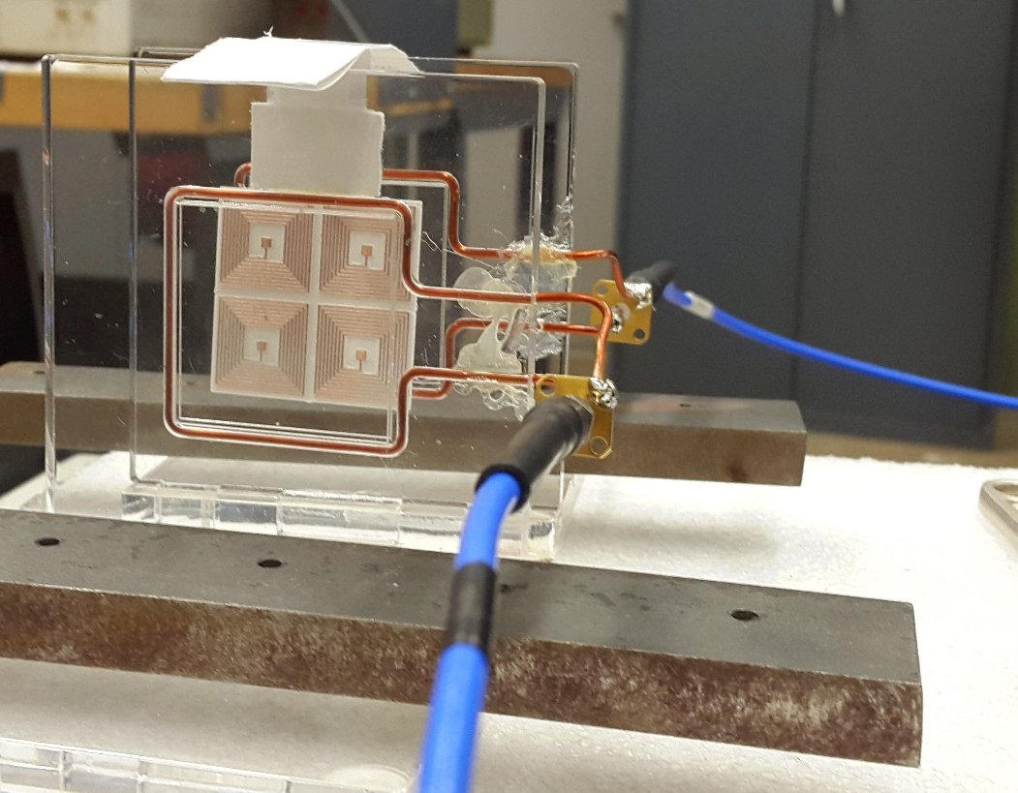
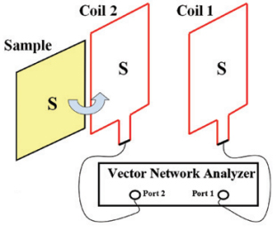

WPT using single negative (-$μ$ permeability) metamaterials
Notes:
In the near-field, we have a magnetic evanescent field, which is a small magnetic wave that is decaying exponentially. At this region, the electric and magnetic field are decoupled. The idea of this project is that since the magnetic evanescent field is decaying exponentially, in order for the receiver coil to get some of the flux, they must be placed closed to each other. However, adding a single negative metamaterial, in this case a negative permeability, it can amplify the magnitude of the magnetic evanescent wave, and therefore, stronger coupling and efficiency of the overall power transfer.

Slide 4
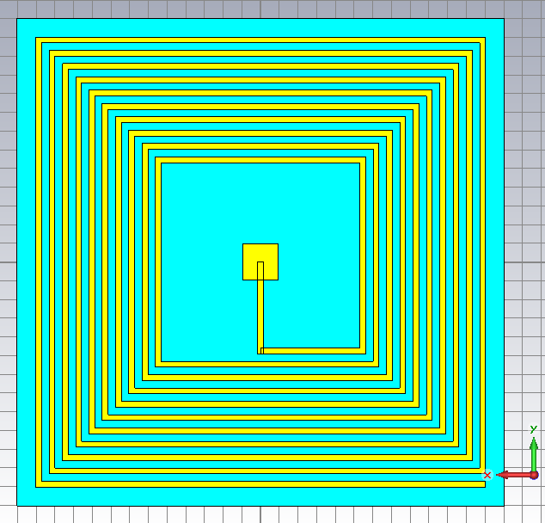
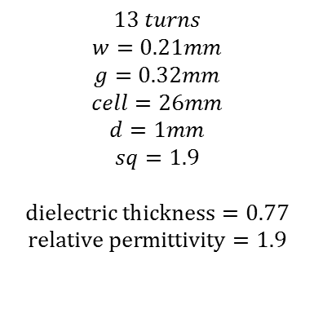
Meta-atom unit cell structure
$$13 turns$$
$$w=0.21mm$$
$$g=0.32mm$$
$$cell=26mm$$
$$d=1mm$$
$$sq=1.9$$
$$dielectric thickness=0.77$$
$$relative permittivity=1.9$$
d
sq
cell
w
w
g
g
Notes:
First simulation following paper. Changed some dimensions. Dielectric thickness changed from 0.25 to 0.77mm

Slide 5
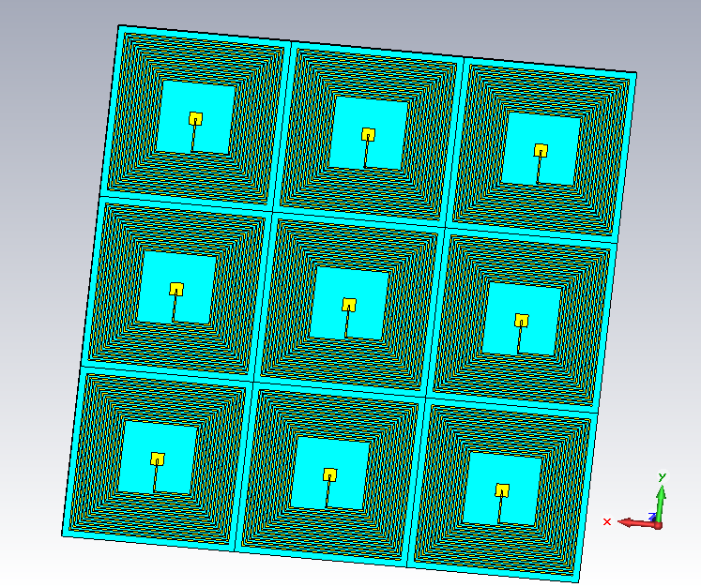
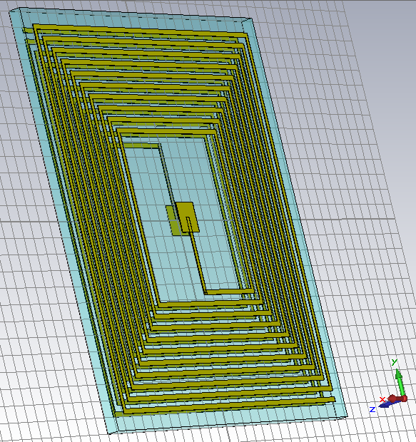
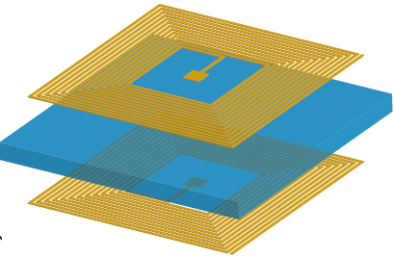
Array of meta-atoms structure

Slide 6
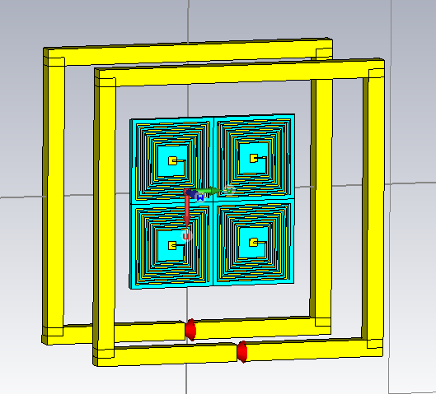
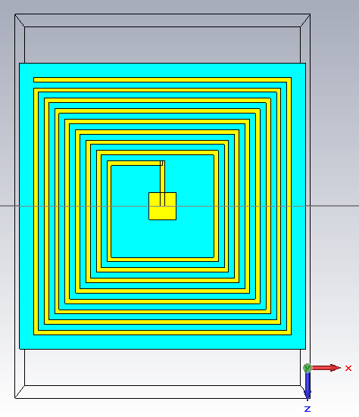
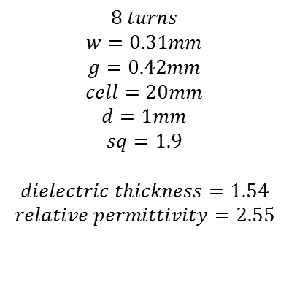
Metamaterial adapted for fabrication
$$8 turns$$
$$w=0.31mm$$
$$g=0.42mm$$
$$cell=20mm$$
$$d=1mm$$
$$sq=1.9$$
$$dielectric thickness=1.54$$
$$relative permittivity=2.55$$

Slide 7
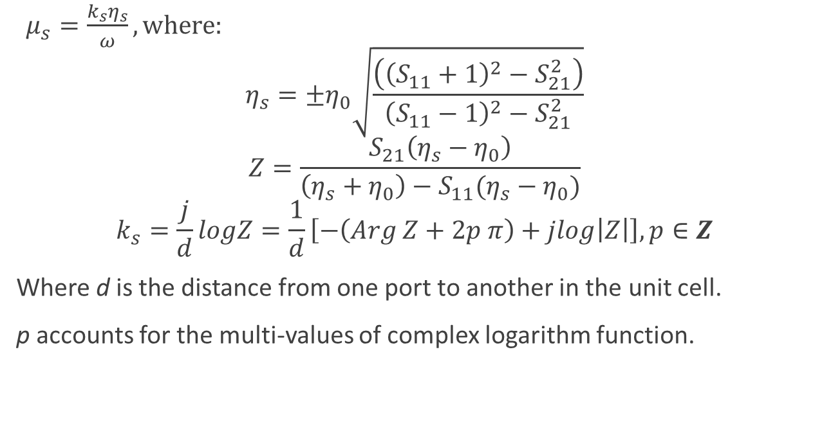
Relative Permeability Calculation
$μ_{s}=\frac{k_{s}η_{s}}{ω}, where:$
$$η_{s}=±η_{0}\sqrt{\frac{\left({\left(S_{11}+1\right)}^{2}−S_{21}^{2}\right)}{{\left(S_{11}−1\right)}^{2}−S_{21}^{2}}}$$
$$Z=\frac{S_{21}\left(η_{s}−η_{0}\right)}{\left(η_{s}+η_{0}\right)−S_{11}(η_{s}−η_{0})}$$
$$k_{s}=\frac{j}{d}logZ=\frac{1}{d}\left[−\left(Arg Z+2p π\right)+jlog\left|Z\right|\right], p∈Z$$
Where d is the distance from one port to another in the unit cell.
p accounts for the multi-values of complex logarithm function.
Notes:
[5] S. Arlanagic et al. “A review of the scattering parameter extraction method with clarification of ambiguity issues in relation to metamaterial homogenization”

Slide 8
Notes:
Tells where the negative permeability happens

Slide 9
Notes:
Tells how much loss we are having at certain frequency. We can see that a lot of loss happens at around 200MHz, but where the negative happens and where our board is working correctly is where the loss is lower, but still in the negative permeability bandwidth.

Slide 10
Notes:
Phase of 180 for negative permeability.

Slide 12
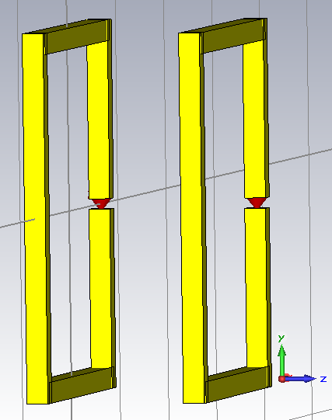
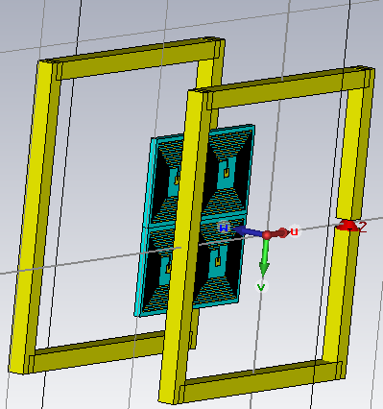

Slide 13
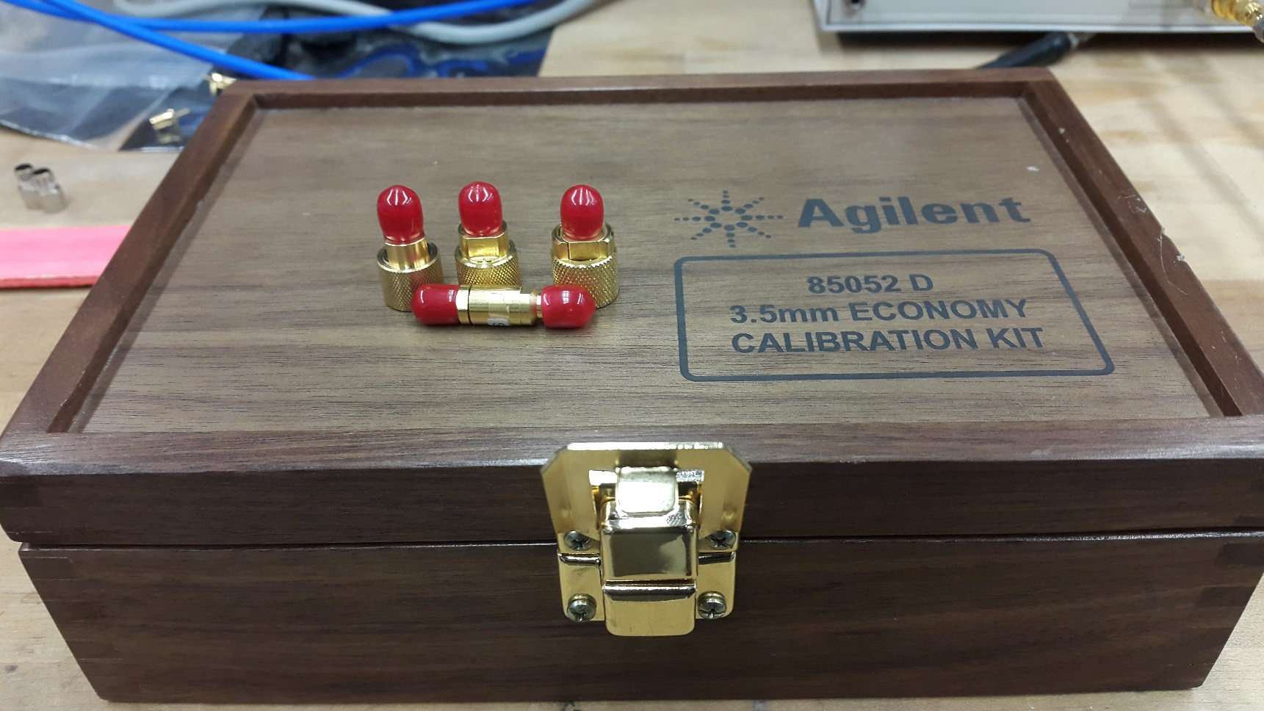
SOLT Calibration

Slide 14
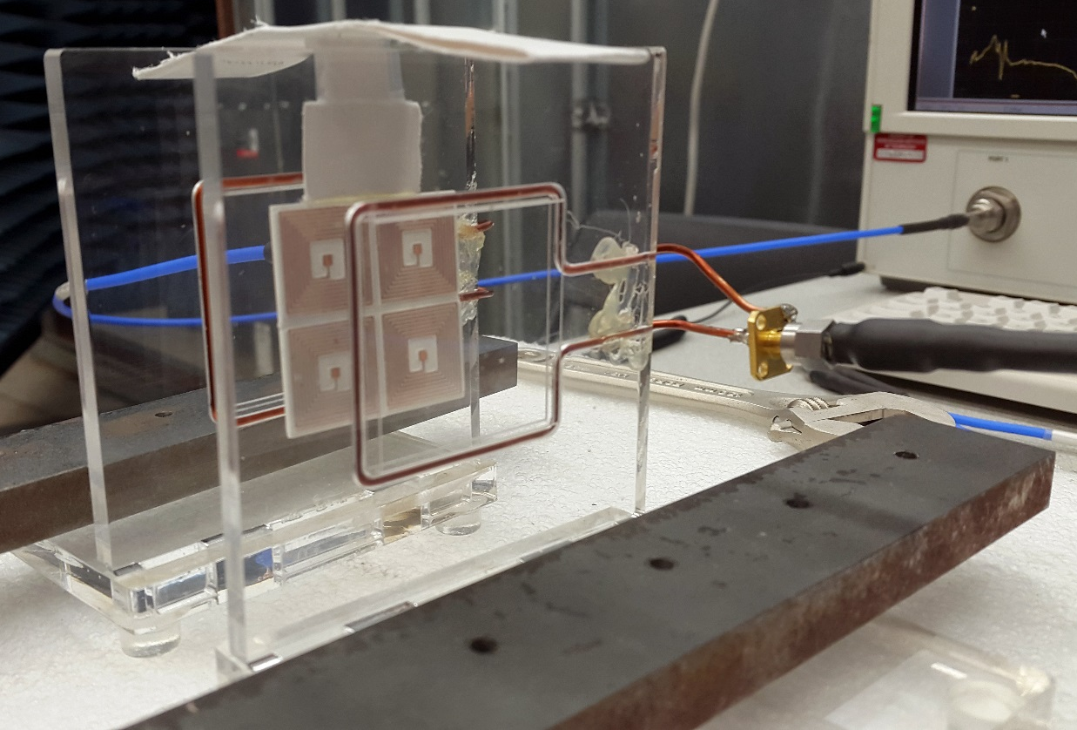
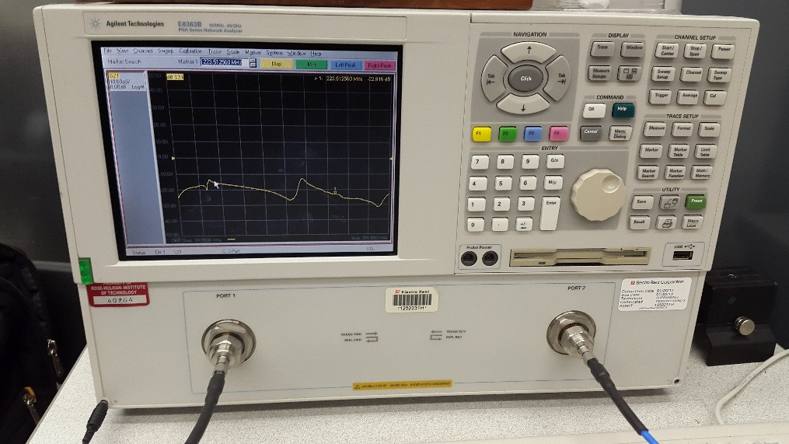

Measurement setup
VNA: $10MHz−40GHz$

Slide 15
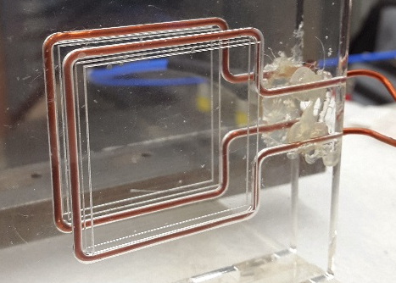
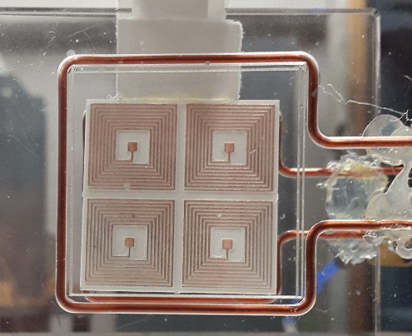

Slide 18
Citation
[1] Q. Wu et al. “Wireless power transfer based on magnetic metamaterials consisting of assembled ultra-subwavelength meta-atoms.”, EPL, 2015.
[2] W.-C. Chen et al. “Extremely subwavelength planar magnetic metamaterials.”, Physics Review, 2012.
[3] Wang, Bingnan et. al. “Experiments on wireless power transfer with metamaterials.”, IEEE, 2011.
[4] Wang, Bingnan et al. “Wireless Power Transfer: Metamaterials and Array of Coupled Resonators”, IEEE, 2013
[5] S. Arlanagic et al. “A review of the scattering parameter extraction method with clarification of ambiguity issues in relation to metamaterial homogenization”

